Slide 1
Image classification with hand drawn images
Group 7
Edmund Ng 1004309
Leon Tjandra 1004353
Lim Yi Lin 1004611
Tan Yan Siew 1004665
Victoria Yong 1004455

Slide 2
Problem Framing
Research Track

Slide 3
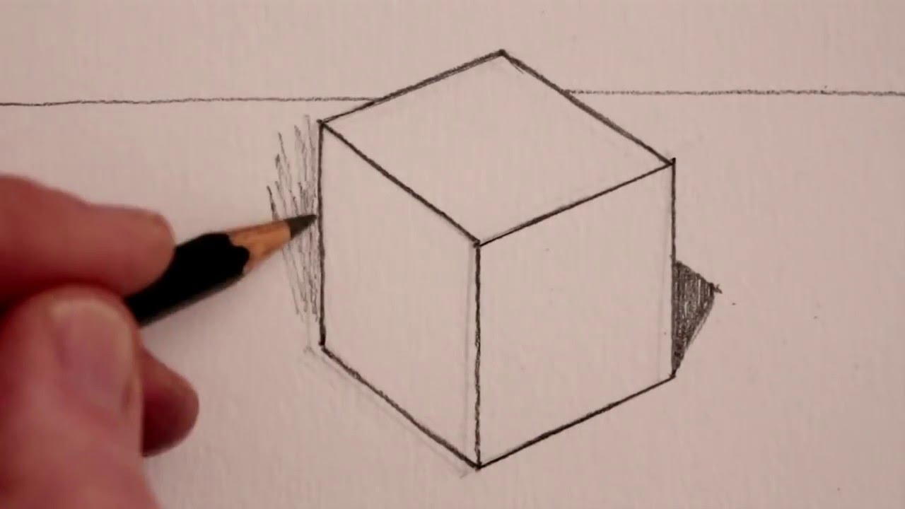
Why are sketches important?
Effective communication tool, can sometimes explain abstract concept better than text with minimal effort
vs
“a symmetrical three-dimensional shape, either solid or hollow, contained by six equal squares.”

Slide 4
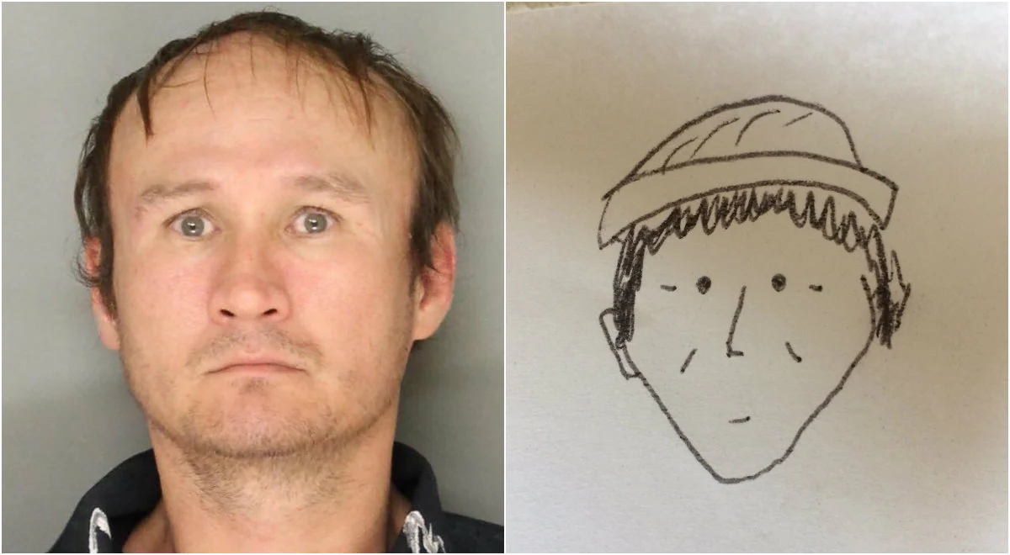
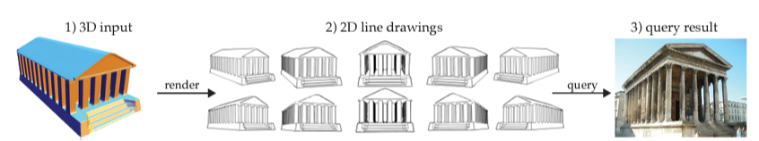
Sketch Recognition: Applications
Face recognition from sketches
The input to the system is a sketch constructed by a witness or an investigator, and the output will be a ranked list of mug shots from the suspect database
2D search from 3D shapes
Helpful for 3D artists modeling and texturing 3D shapes: extracting such data from real photos is a frequent task but the search for adequate images is tedious.
Notes:
2d search from 3d
the user starts by choosing a 3D object in a shape repository and selects an appropriate viewpoint in which renders the view using recent line drawing algorithms

Slide 5
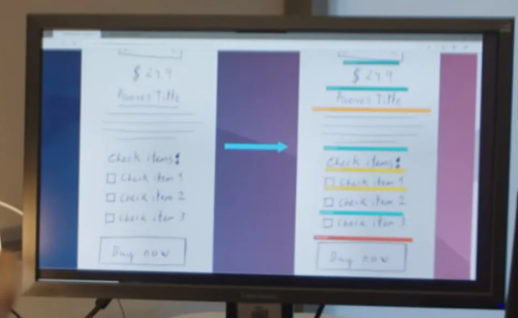
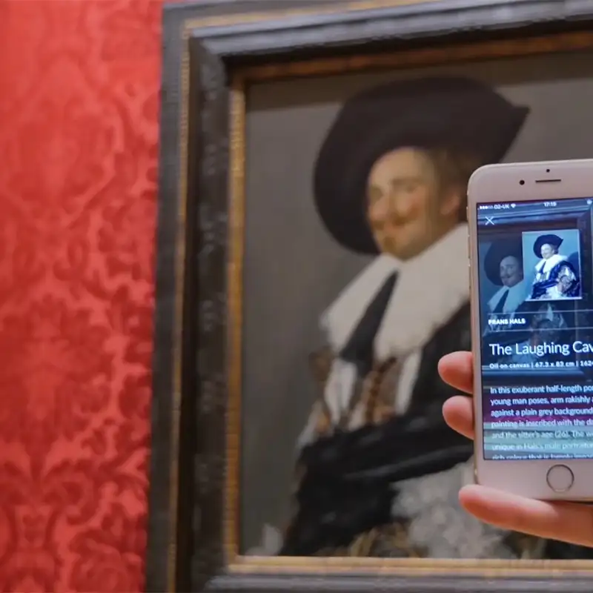
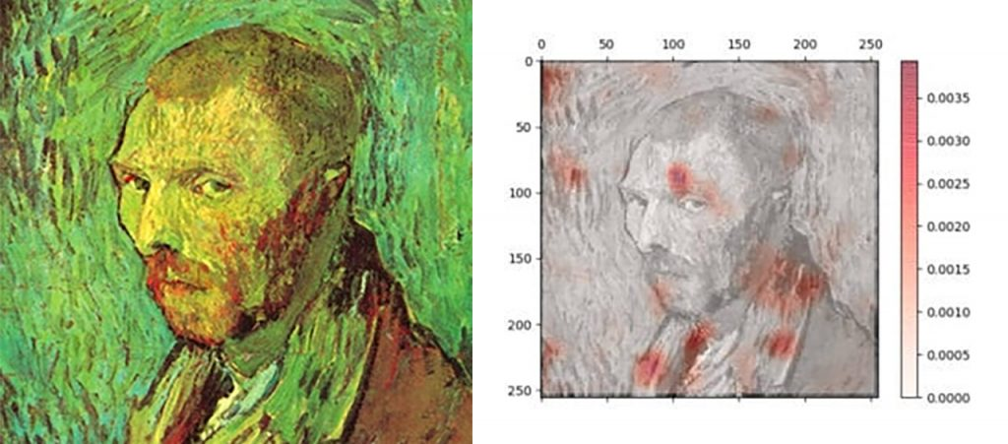
Sketch Recognition: Applications
Sketch2Code
Sketch2Code uses AI to convert drawings to working HTML prototypes. Designers share ideas on a whiteboard, then changes are shown in the browser instantly.
Other applications:
Communication aids for children or illiterate
Novel dataset generation
Game Design
Notes:
2d search from 3d
the user starts by choosing a 3D object in a shape repository and selects an appropriate viewpoint in which renders the view using recent line drawing algorithms

Slide 6
Innovations in Sketch Detection
Generative Design
Extending classification problems to learn the class feature space and generate new data.
E.g. Generating sketch images based on keywords and its associated class (NLP + CNN)
E.g. Generating sequential images like animations or storyboarding (RNN/Transformer architectures + CNN)
E.g. Generating 3D models/ CAD models from sketch images/sequence of sketch images
Texture/Art Medium Classification
E.g. chalk, watercolour, graphite
Classifying and/or generating sketches in different art styles
Layer detection in Art/Photos
Classifying objects in the photo and separating the image into its background, foreground, and any other prominent layers
Automatic Sketch Colouring
Detection of object and its features in a sketch and generating a coloured version

Slide 7

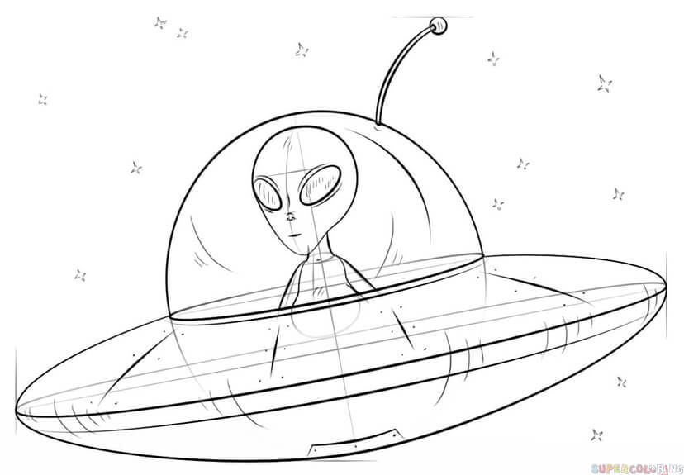
Difficulties in sketch classification
Abstract & Symbolic
Beyond reality
Notes:
Note: Abstract sketch may induce ambiguity

Slide 8
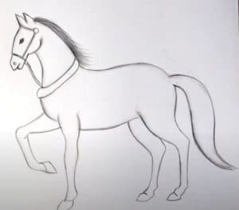
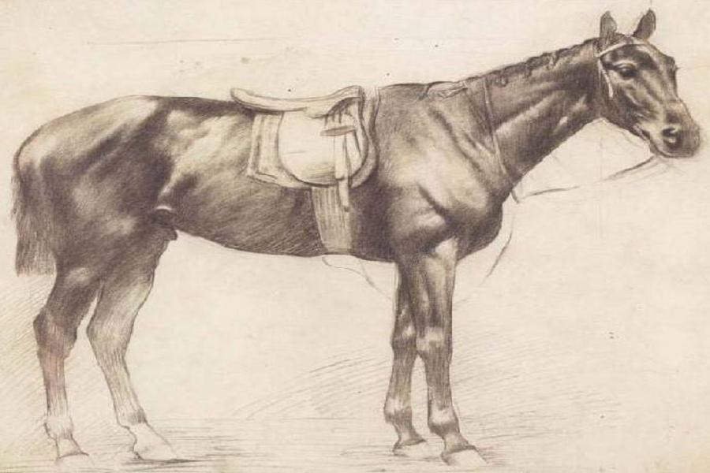
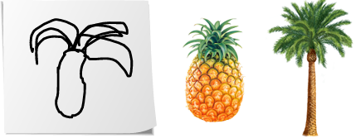
Difficulties in sketch classification
Sketches of the same object may have different shapes and level of detail
Lacks colour and texture information

Slide 9
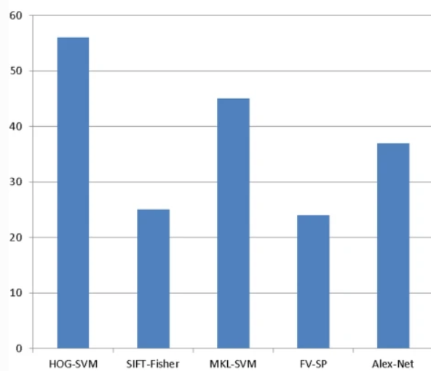
Sketch Recognition: What has been done so far
Using different algorithms:
HOG-SVM
SIFT-FISHER
MKL-SVM
FV-SP
Alex-Net
Training time(h)

Slide 10
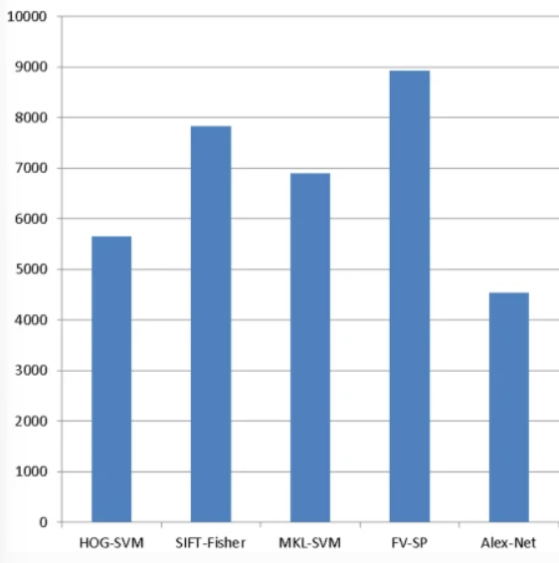
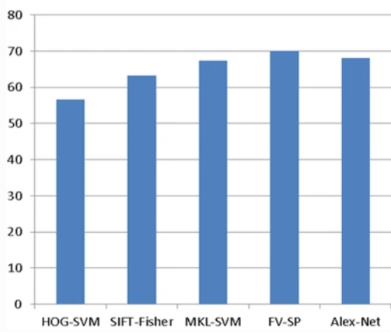
Sketch Recognition: What has been done so far
Energy Consumption (j)
Recognition rate%

Slide 11
Initial Solution Idea

Slide 12
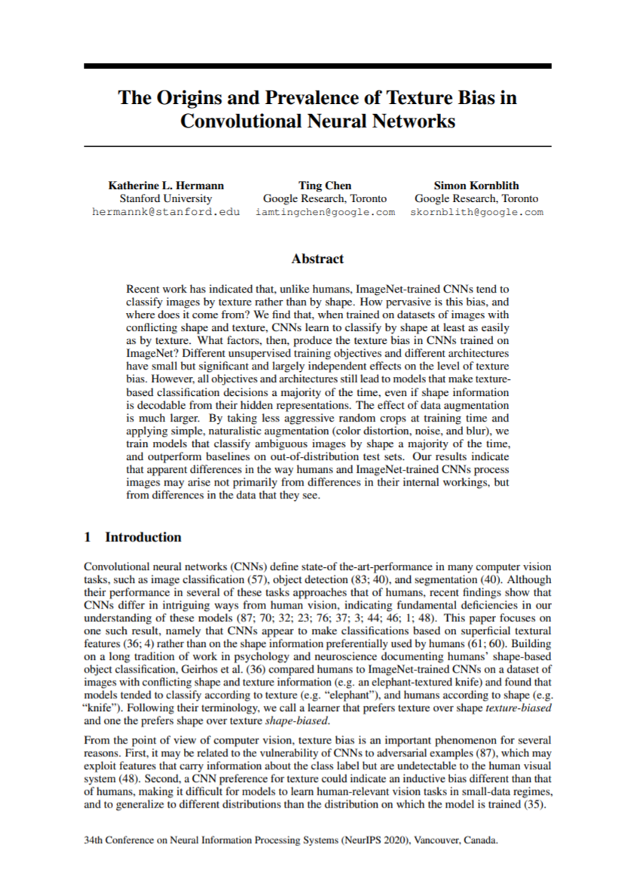
Key Ideas
Using concepts and ideas from the research paper titled: The Origins and Prevalence of Texture Bias in Convolutional Neural Networks, we try to improve the performance of CNNs in classifying sketches by focusing more on the Shape Bias as opposed to Texture Bias
Data Augmentation to increase Shape Bias:
Color Distortion
Gaussian Blur
Gaussian Noise
Notes:
Research Paper Source: https://proceedings.neurips.cc/paper/2020/file/db5f9f42a7157abe65bb145000b5871a-Paper.pdf

Slide 13
Datasets

Slide 14
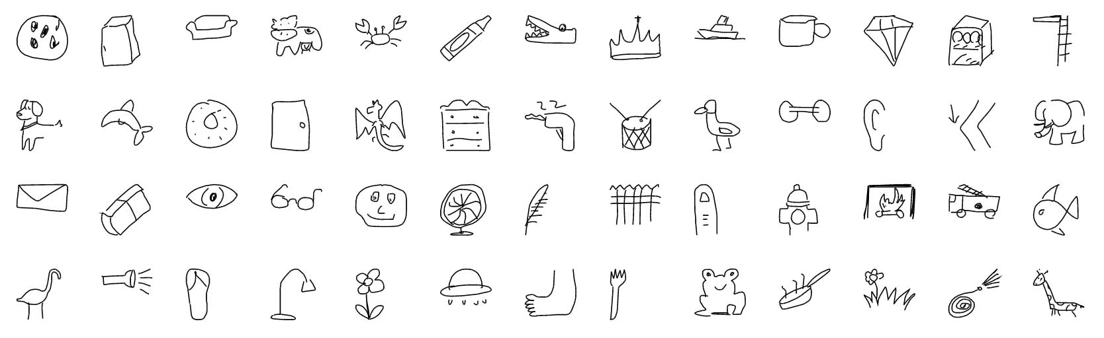
Quick Draw! Google Dataset
Contributed by players of the game Quick, Draw!
50 million drawings across 345 categories
Captured as timestamped vectors, tagged with metadata
Country of player
Game prompt

Slide 15
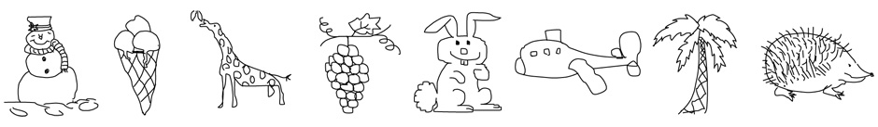
Cybertron Berlin Dataset
Crowd-sourced dataset
Non-expert sketches of everyday objects
20,000 images over 250 categories
Perceptual Study: humans can correctly identify the object category of a sketch 73% of the time

Slide 16
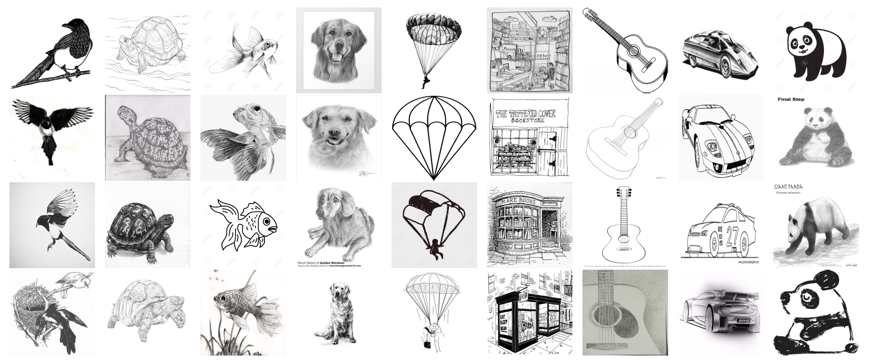
ImageNet-Sketch Dataset
ImageNet is an image database organized according to the WordNet hierarchy
50000 images, 50 images per class (1000 classes)
Black and white images only

Slide 17
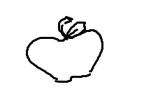

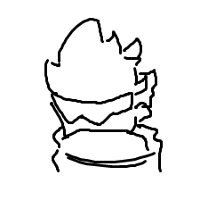
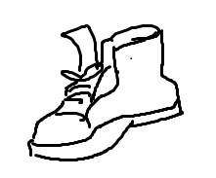

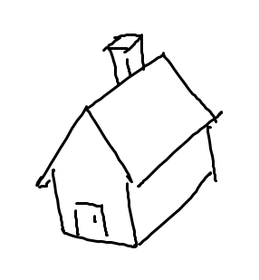

Our hand-drawn sketches
Primarily for test datasets

Slide 18
The Models

Slide 19
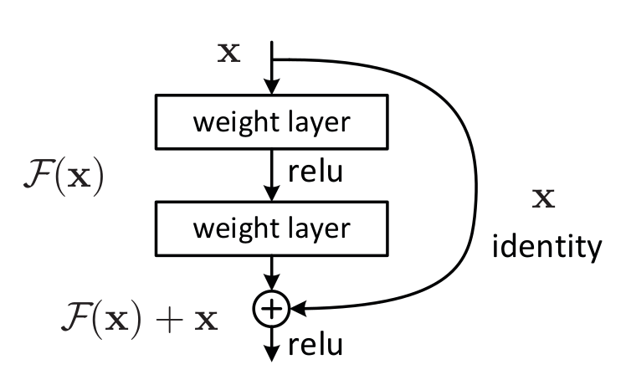
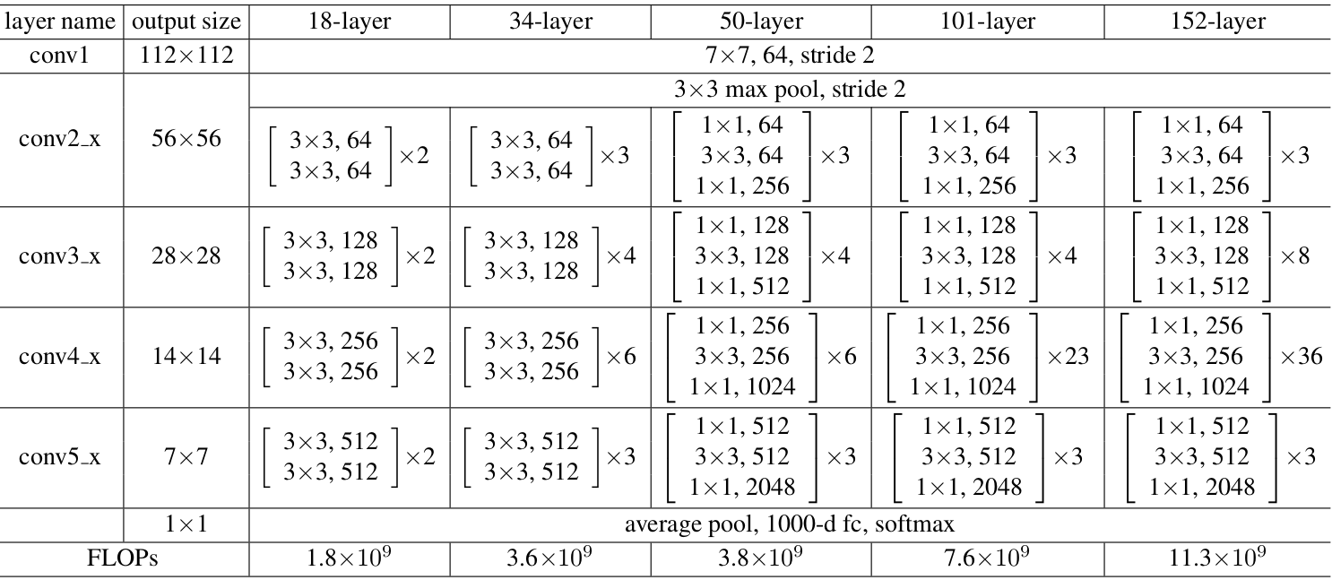
ResNet-50
Deep residual learning framework
50 layer deep convolutional neural network
48 Convolutions, 1 Max Pool, 1 Average Pool
Pre-trained on ImageNet dataset
Trained on 1000 different object classes
Notes:
deep residual learning framework introduced shortcut connections that simply perform identity mappings
They explicitly let the layers fit a residual mapping and denoated that as H(x) and they let the non linear layers fit another mapping F(x):=H(x)−x so the original mapping becomes H(x):=F(x)+x
And the benifit of these shortcut identity mapping were that there was no additional parameters added to the model and also the computational time was kept in check.

Slide 20
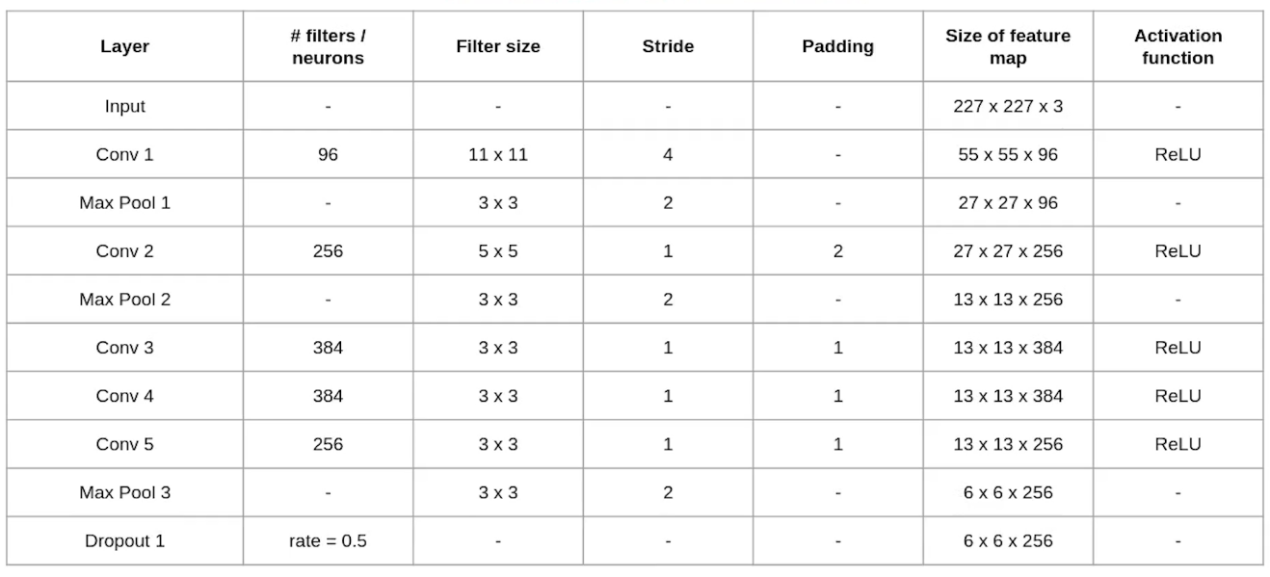
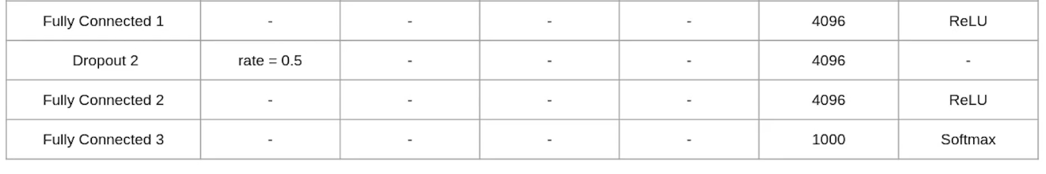
AlexNet
Eight layers with learnable parameters
5 convolutions, 3 FC, 3 Max pool, 2 dropout
ReLU to speed up training
Pre-trained on ImageNet dataset
Trained on 1000 object classes (same as ResNet-50)

Slide 21
Design Direction
Construct the neural network model using pretrained AlexNet and ResNet-50 on the ImageNet RGB dataset (based on paper)
Train the networks on the ImageNet-Sketch dataset (same as paper)
Perform image preprocessing and data augmentation techniques one-by-one based on research paper
Test the performance of trained models/neural networks on test dataset and record results
Analyze, visualize, and summarize findings from results
Notes:
The model on the paper is trained on Imagenet RGB before image net sketch thus it is not purely sketch, we can Compare it with baseline model trained directly on image sketch dataset
Focus on one dataset, preferably the one mentioned in the paper (ImageNet Sketch)

Slide 22
Design Direction (Extras)
Train and test the models on the other Sketch datasets
Create a new naive NN model trained on only the sketch dataset
Compare results with the methods described in the paper
Notes:
Notes:
[1] Other datasets includes Quick Draw! Google Sketch and Cybertron Berlin Dataset as well as our own Novel Sketch Dataset
[2] Build a Naive Neural Network model from Scratch and Train it on ImageNet Sketch
[3] Compare the performance of baseline model with pre-trained AlexNet and ResNet from the paper

Slide 23
Input
Model
Output
ImageNet (Full RGB)
Vector of
Class
Predictions
ImageNet-Sketch
Dataset
ResNet-50/AlexNet
Network Architecture
Notes:
For our main experiment, we try to replicate the results from the research paper using a pretrained AlexNet and ResNet-50 model, the specifications are as follows:
Model: AlexNet and ResNet-50 (pre-trained with ImageNet RGB)
Training Dataset: ImageNet-Sketch Dataset
Test Dataset: ImageNet-Sketch Dataset
Performance Metric: top-1 accuracy, top-5 accuracy

Slide 24
Input
Model
Output
ImageNet-Sketch
Vector of
Class
Predictions
ImageNet-Sketch
Dataset
Baseline Model (From Scratch)
Network Architecture: Extra Ideas
Notes:
If time permits, it will be an interesting experiment to see how well a baseline model performs if it is Trained on the ImageNet-Sketch and Tested on the Sketch for comparison against the pre-trained models from the research paper.
Model: Baseline Model (from Scratch)
Training Dataset: ImageNet-Sketch Dataset
Test Dataset: ImageNet-Sketch Dataset
Performance Metric: top-1 accuracy, top-5 accuracy

Slide 25
Timeline

Slide 26
Week 6
Week 7
Week 8
Week 9
Checkoff 2 Project Presentation
Create Classifiers Based on Paper
Test Classifiers on ImageNet-Sketch dataset
Experiment 1: Color Distortion
ALL:
Each member to read the selected research paper
Checkoff-2 Preparation
Additional research and literature review
Group 1: AlexNet
Group 2: ResNet-50
Each group to implement a classifier
Debug classifier to ensure it runs without errors
ALL: Draw some hand-drawn images for validation dataset (20 images per person, 256x256px)
Each group to train classifier on ImageNet-Sketch dataset without any data augmentation, test classifier on test and validation datasets and record results
Note: Standardize train/test split ratio and stratification
Apply color distortion on dataset
Each group to train classifier on ImageNet-Sketch dataset with Color Distortion, test classifier on test and validation datasets and record results

Slide 27
Week 10
Week 11
Week 12
Week 13
Experiment 2: Gaussian Blur
Experiment 3: Gaussian Noise
Prepare Checkoff 3
Checkoff 3 Project Presentation and Demonstration
Project Report and Poster
Perform Gaussian Blur on dataset
Each group to train classifier on ImageNet-Sketch dataset with Gaussian Blur, test classifier on test and validation datasets and record results
Perform Gaussian Noise on dataset
Each group to train classifier on ImageNet-Sketch dataset with Gaussian Noise, test classifier on test and validation datasets and record results
ALL:
Prepare presentation slides, report and poster
If time permits, attempt to tackle the extra tasks:
Create naive model (not pre-trained)
Train and test the model
Compare results with ResNet-50 and AlexNet models
Prepare Report and poster for submission
Notes:
Each group to train classifier on hand-drawn images dataset without any data augmentation, test classifier on validation dataset and record results

